Slide 1
Meeting 07/03/2020
Shuo Zhang

Slide 2
Progress
 | A* Plan | A* Rollout | PPO Plan | PPO Rollout | Online Method
Acrobot | Done | Done | Done | Done | Need to discuss in more details
Reacher | Done | Done | Done | Done | Need to discuss in more details
Gazebo Hand (normal obstacles + horseshoe ) | Done | Done | Done | Done | Need to discuss in more details
Real Had (no obstacles) | Done | Wait for Mridul until the marker issues fixed | In Progress (Hyperparameter Search) | Wait for Mridul until the marker issues fixed | Need to discuss in more details

Slide 3
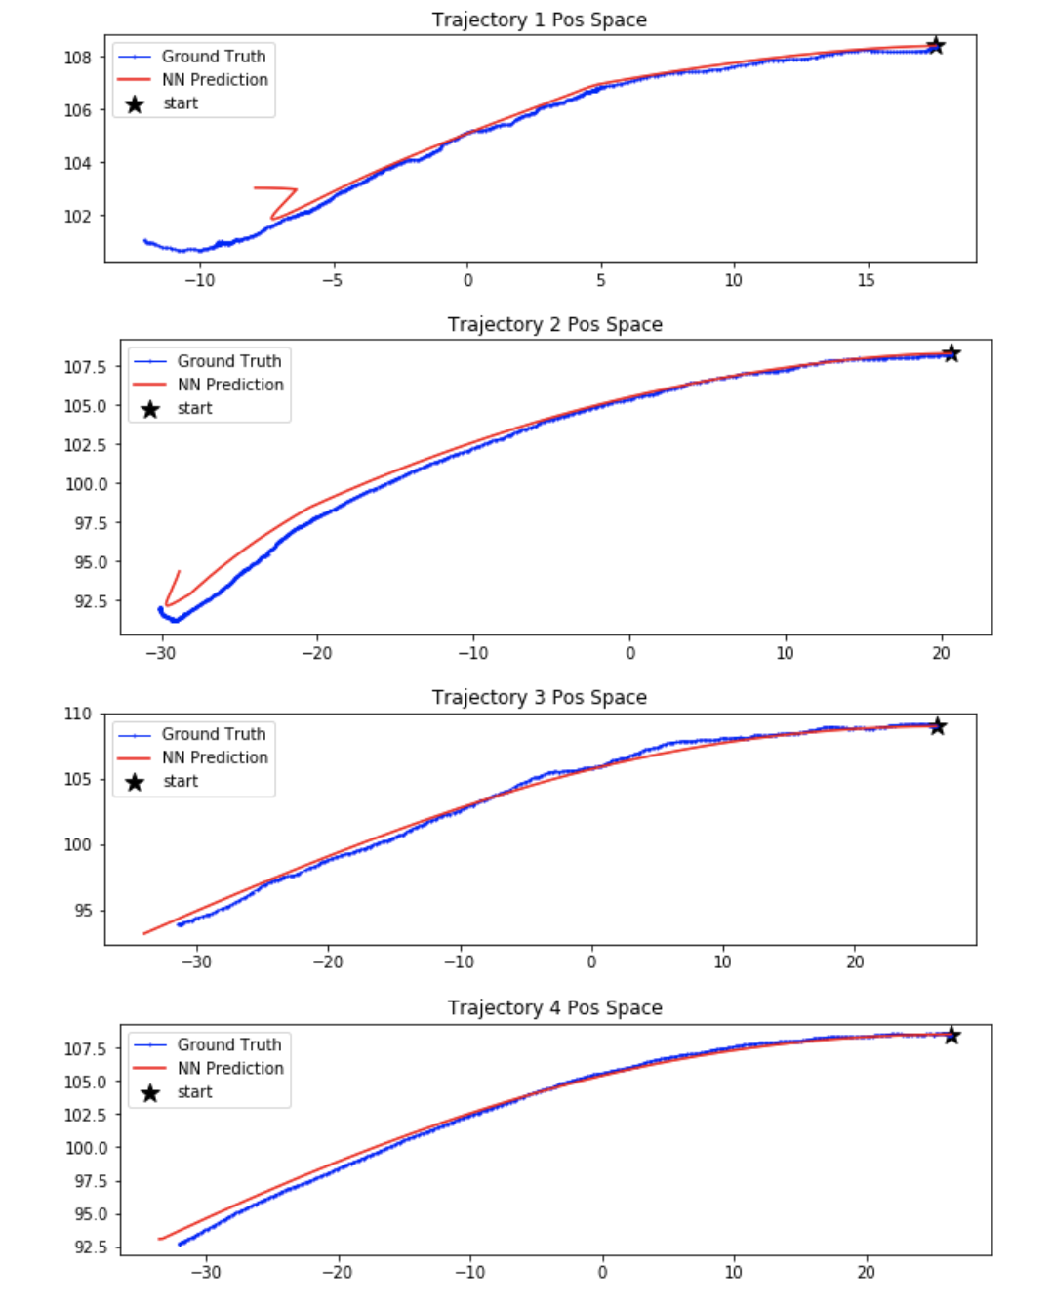
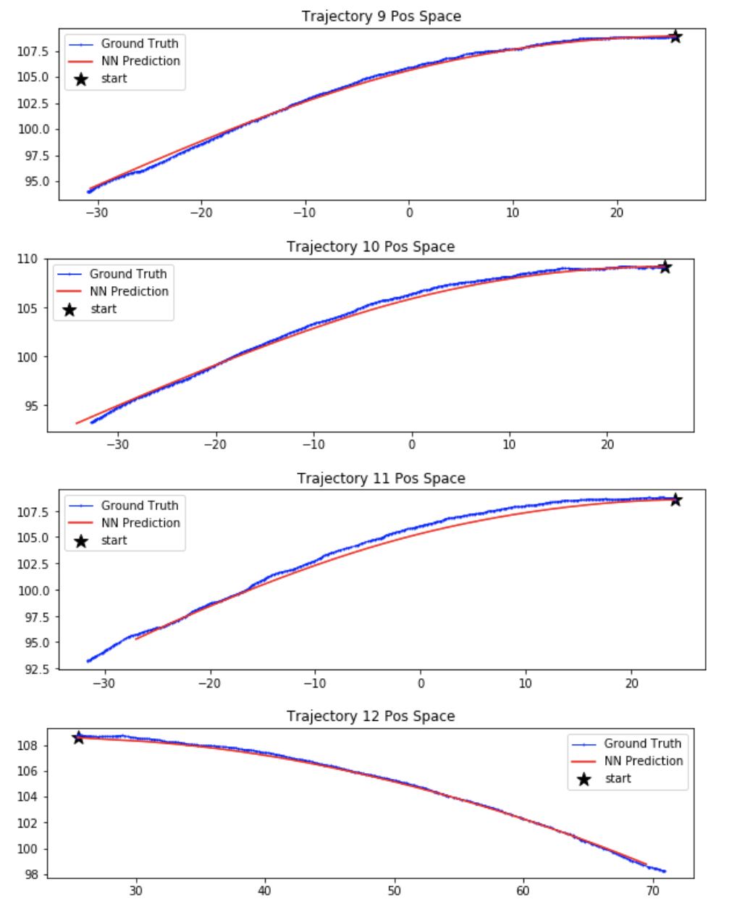
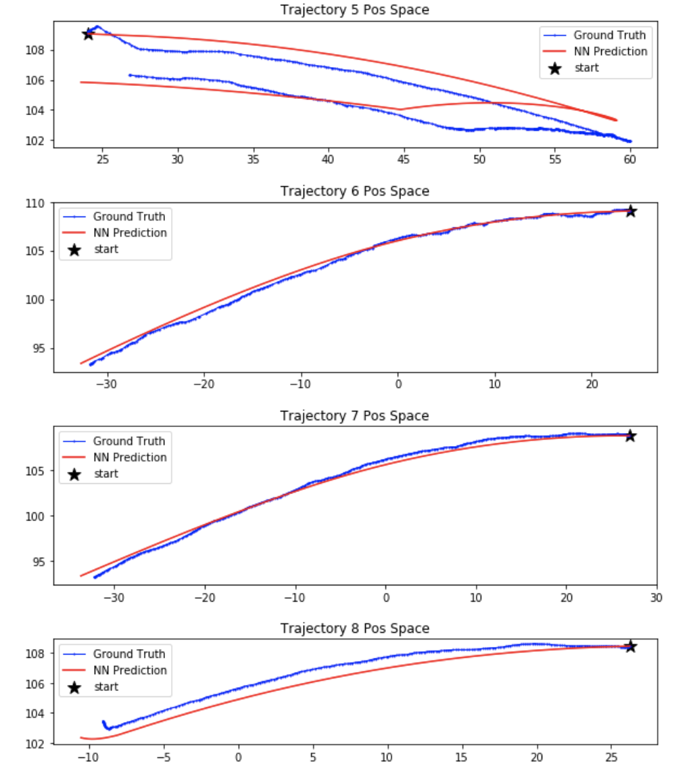
Real Hand Dynamic Model
(missing z values are calculated)

Slide 4
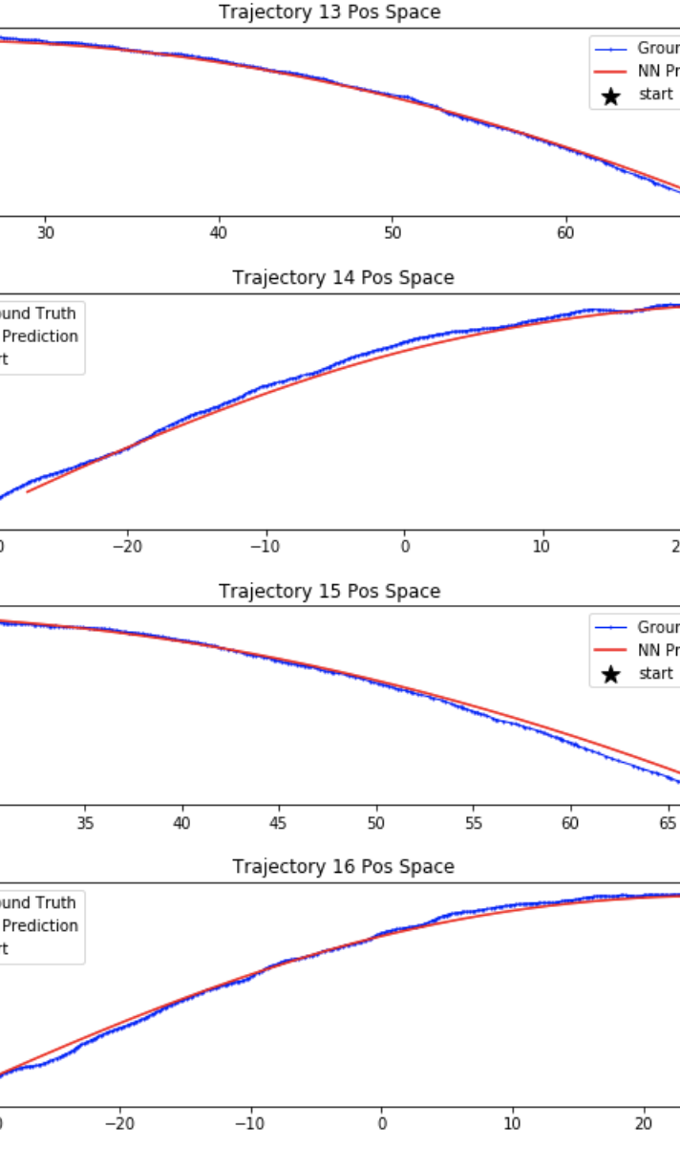
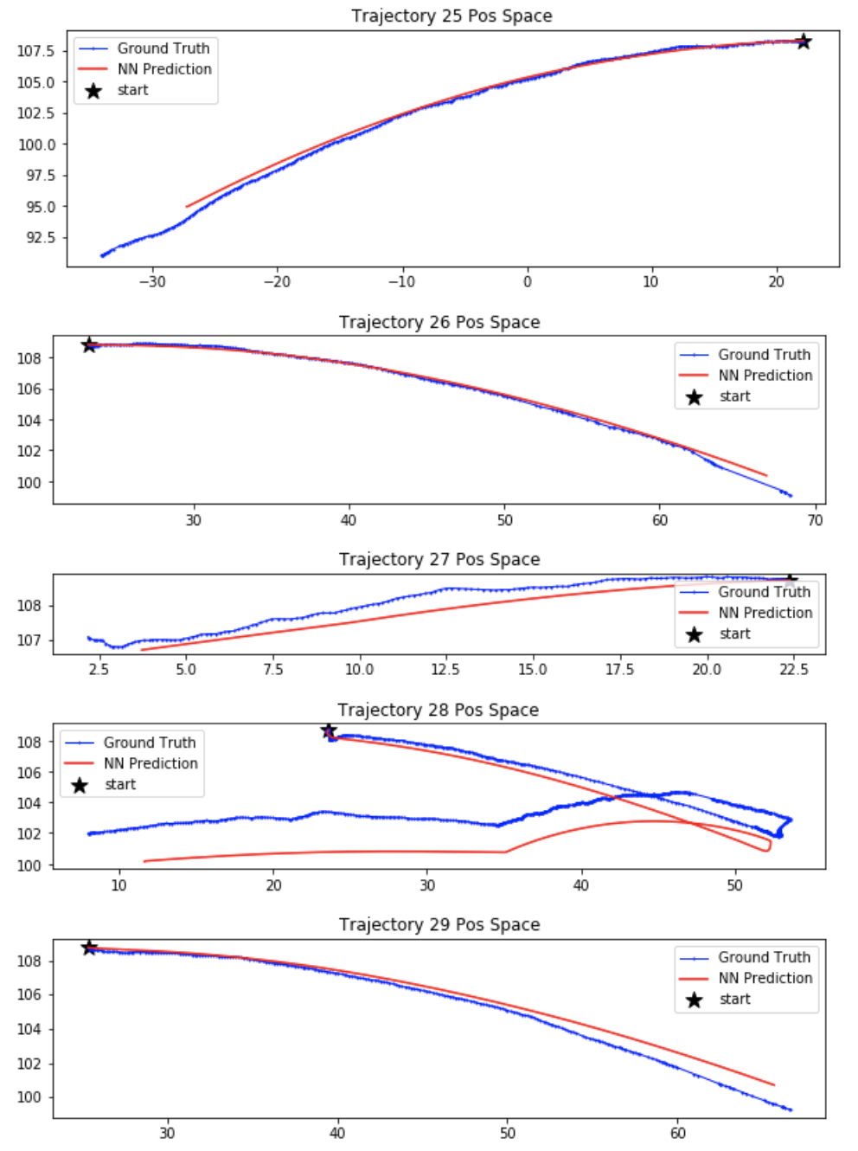
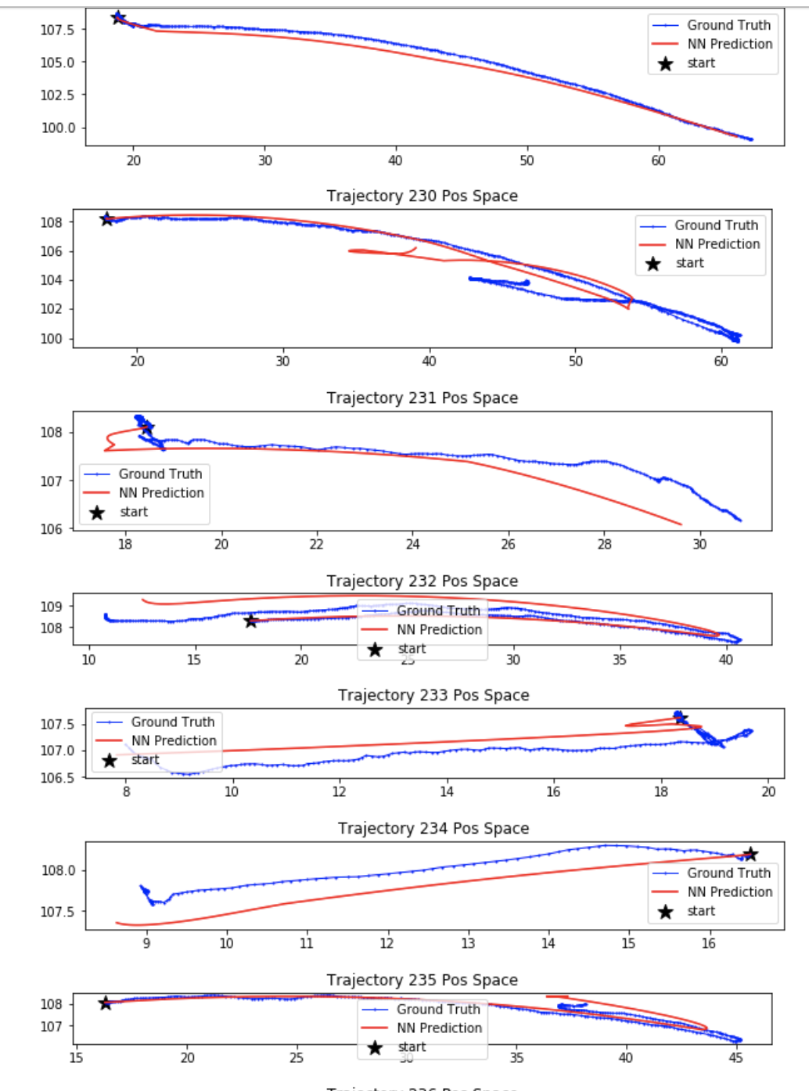

Slide 5
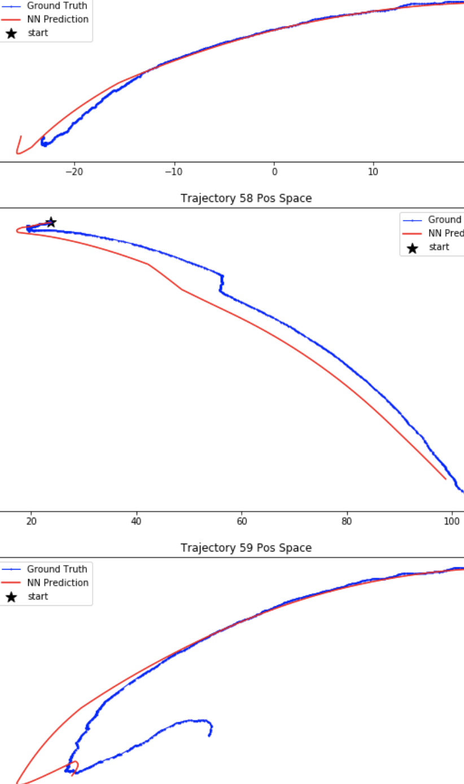
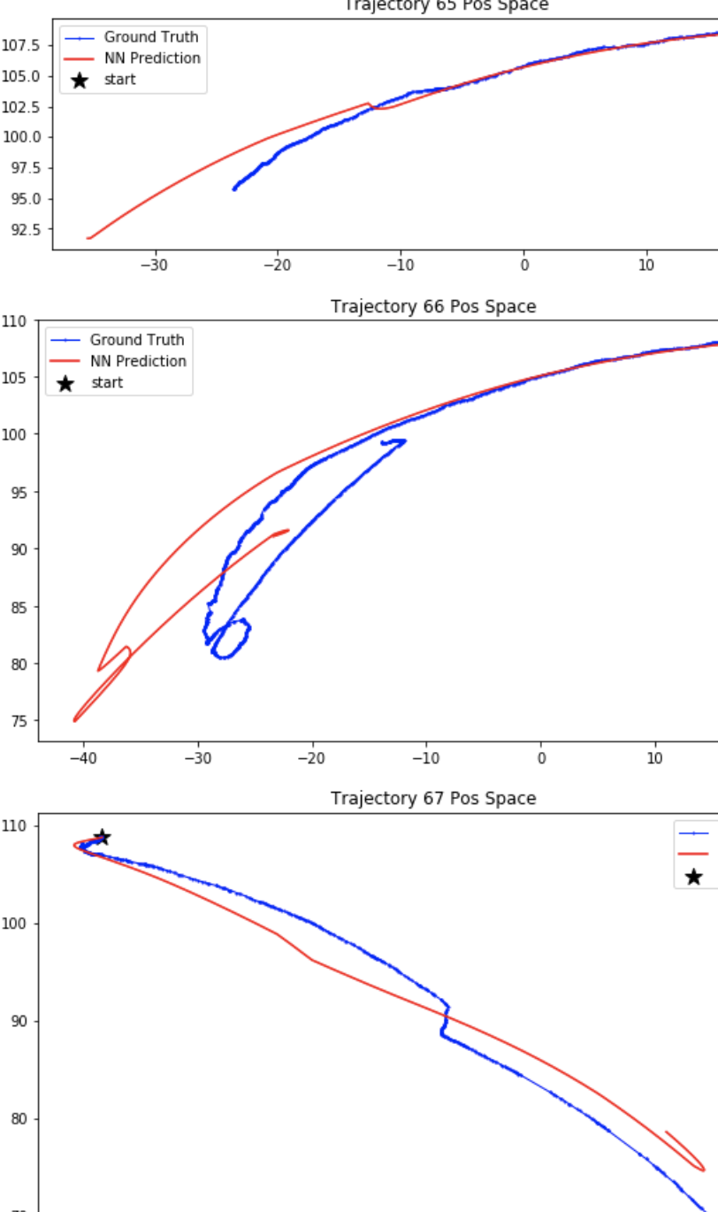
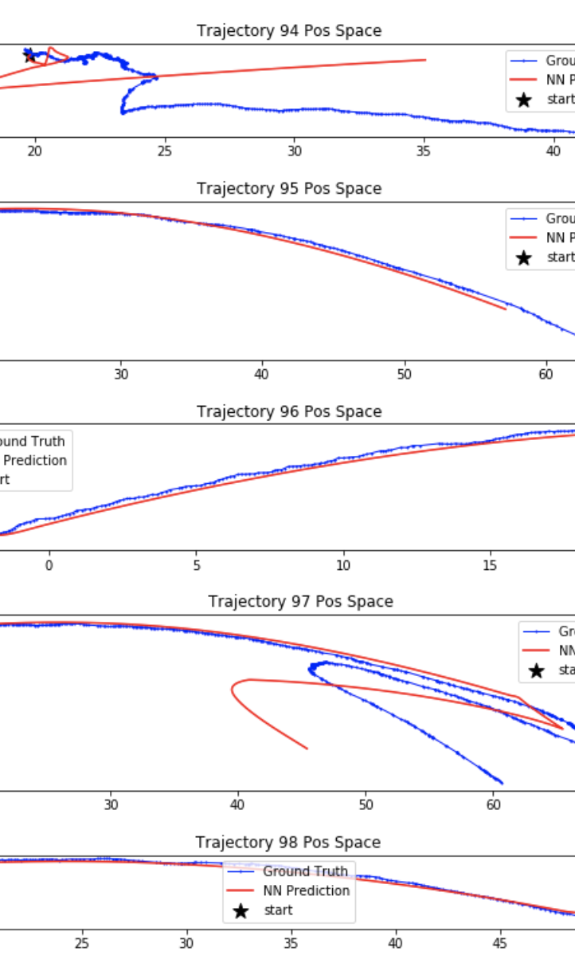

Slide 6
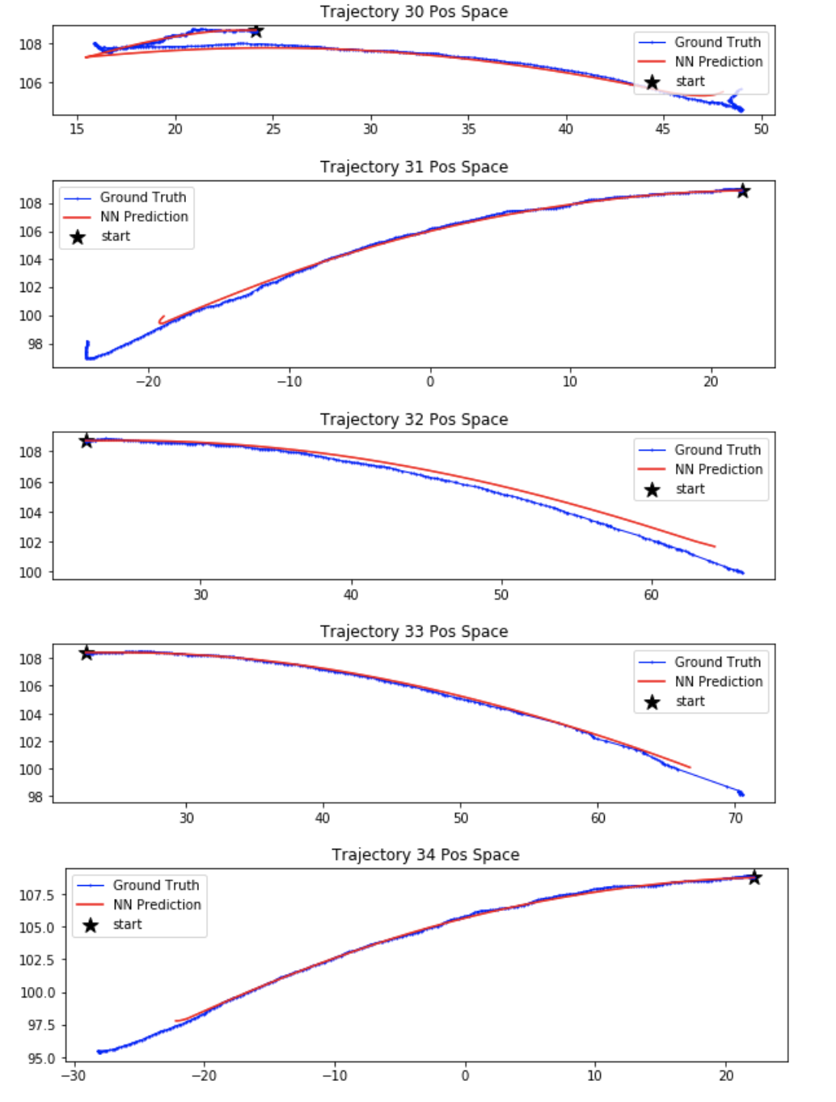
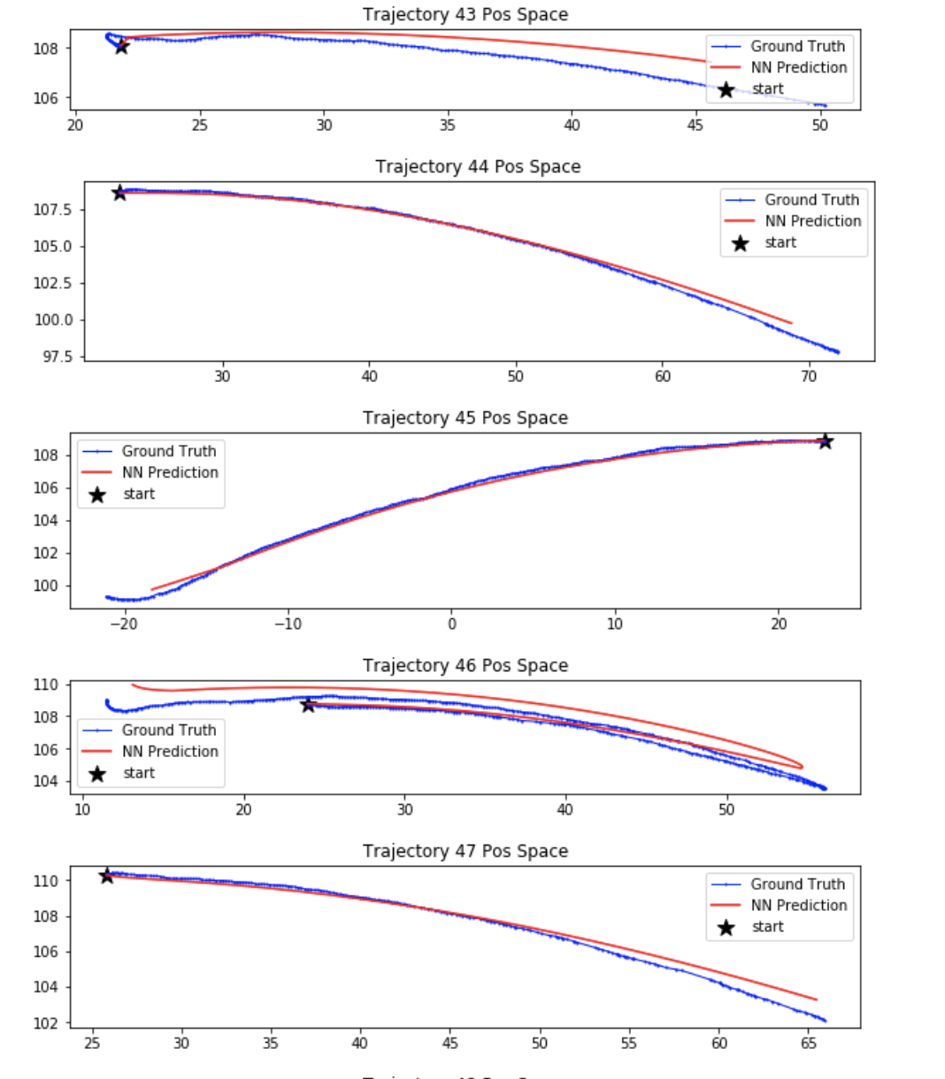

Slide 7
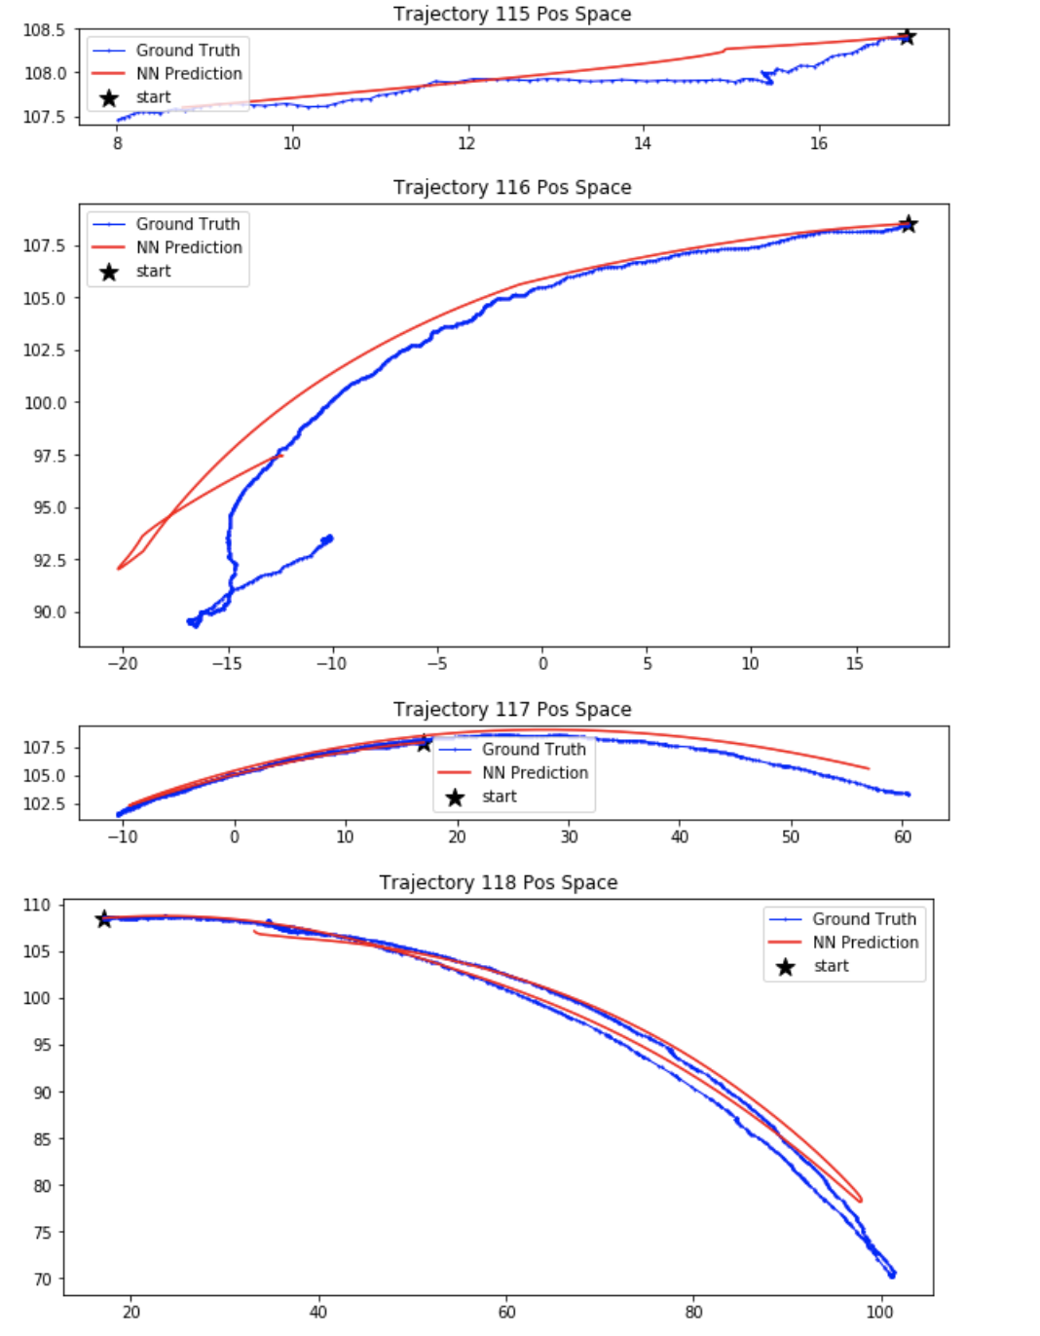
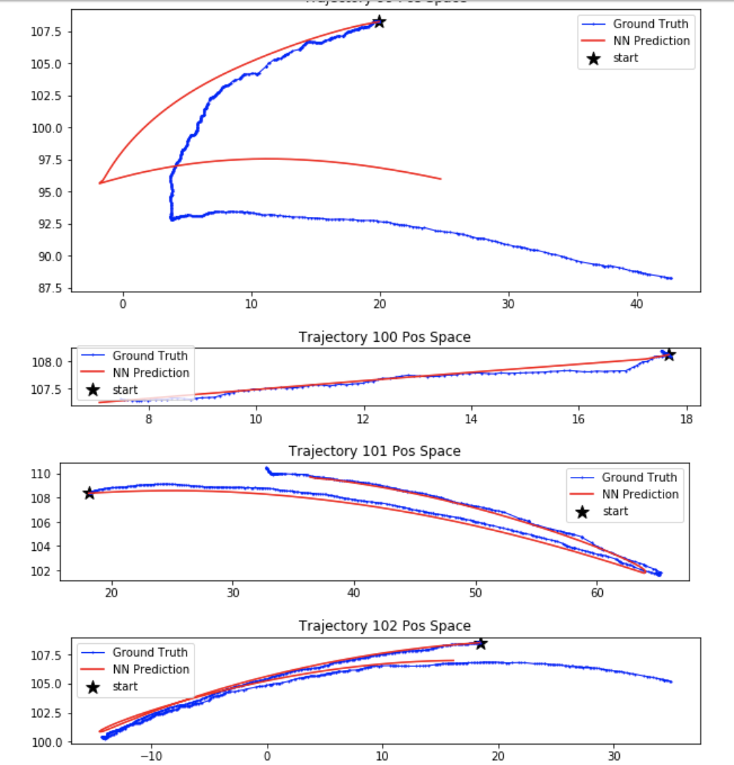

Slide 8
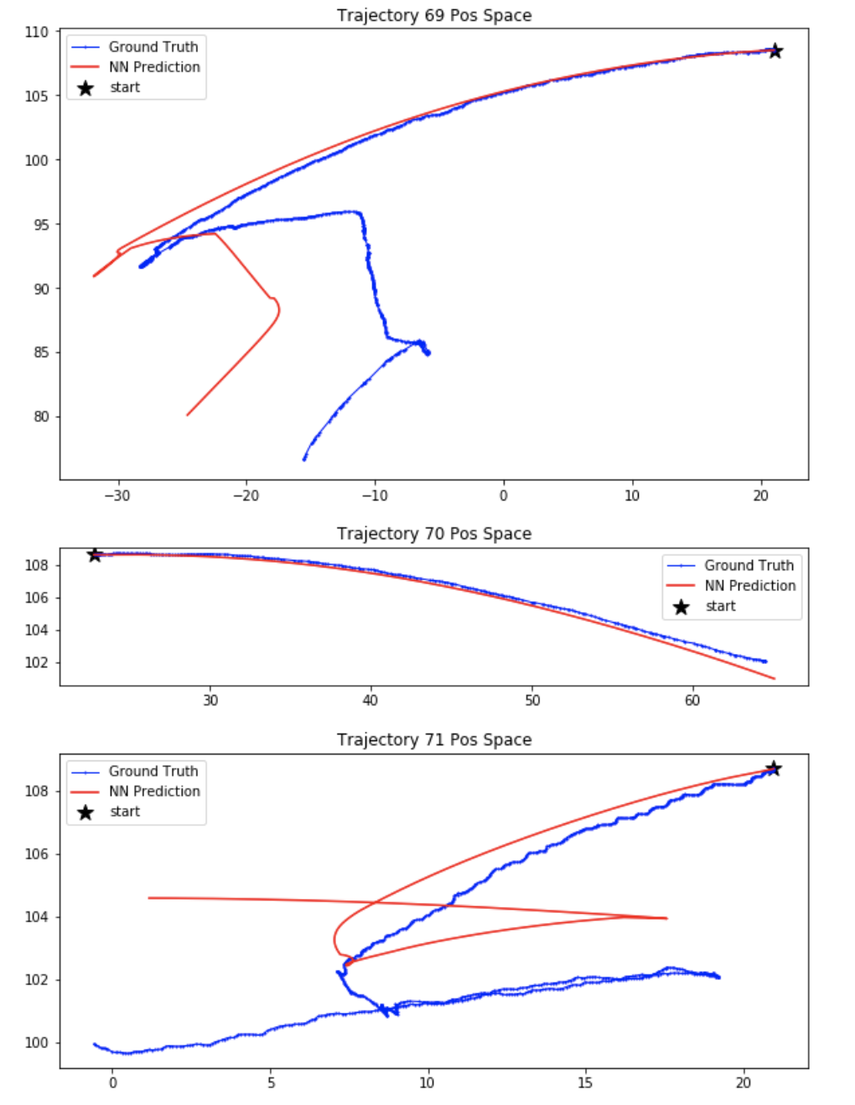
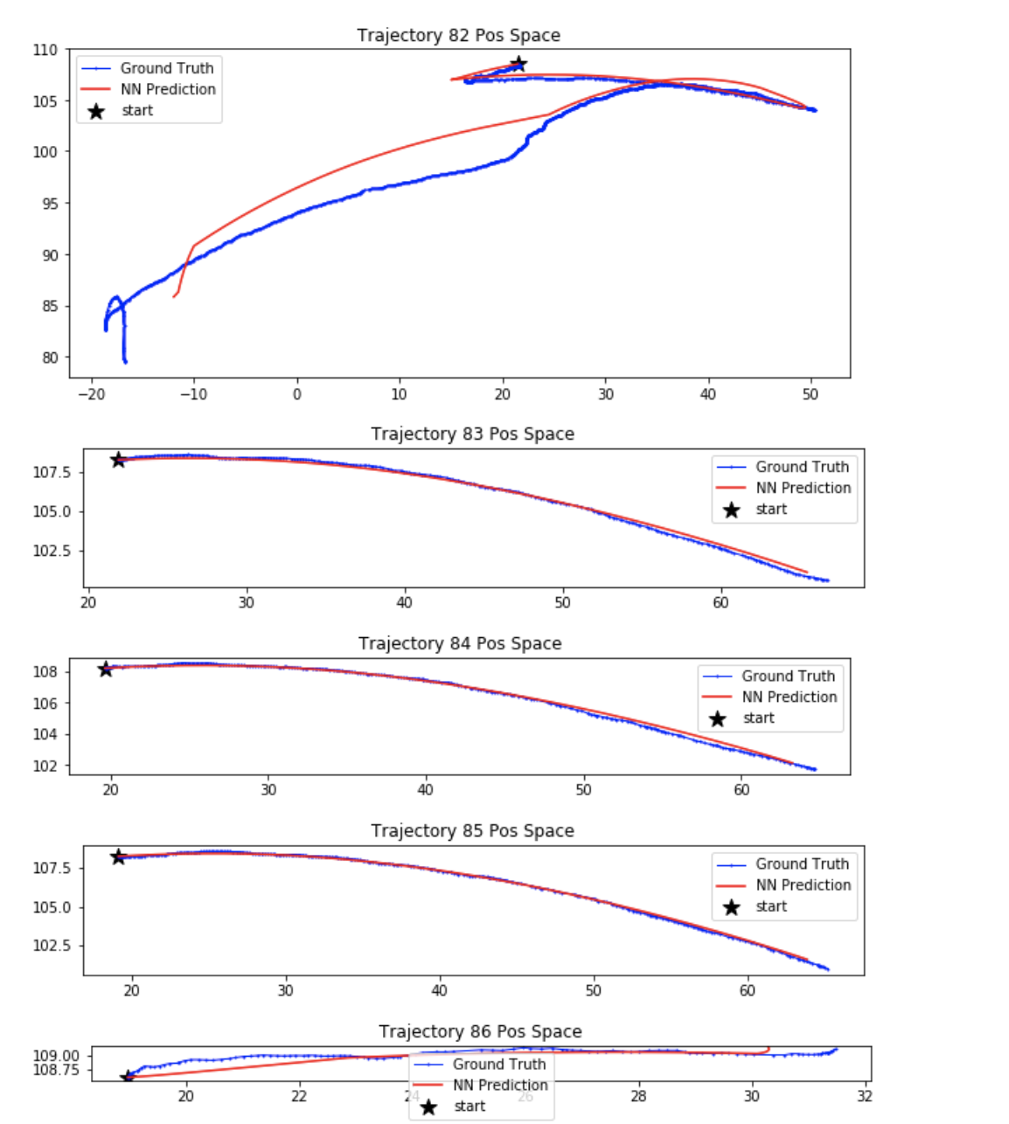
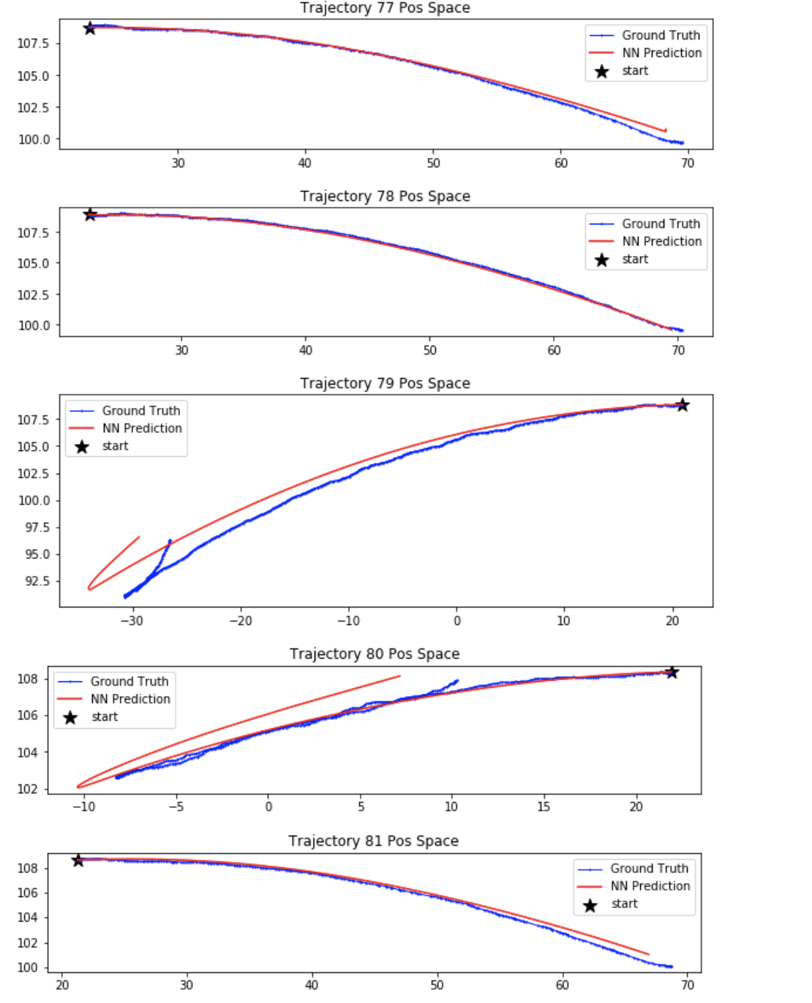

Slide 9
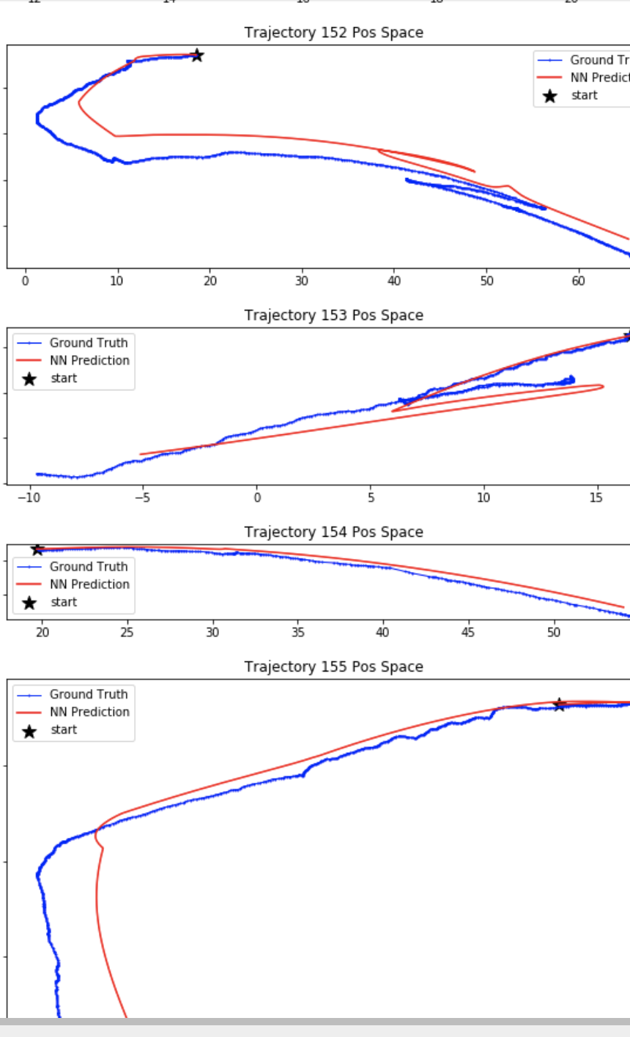
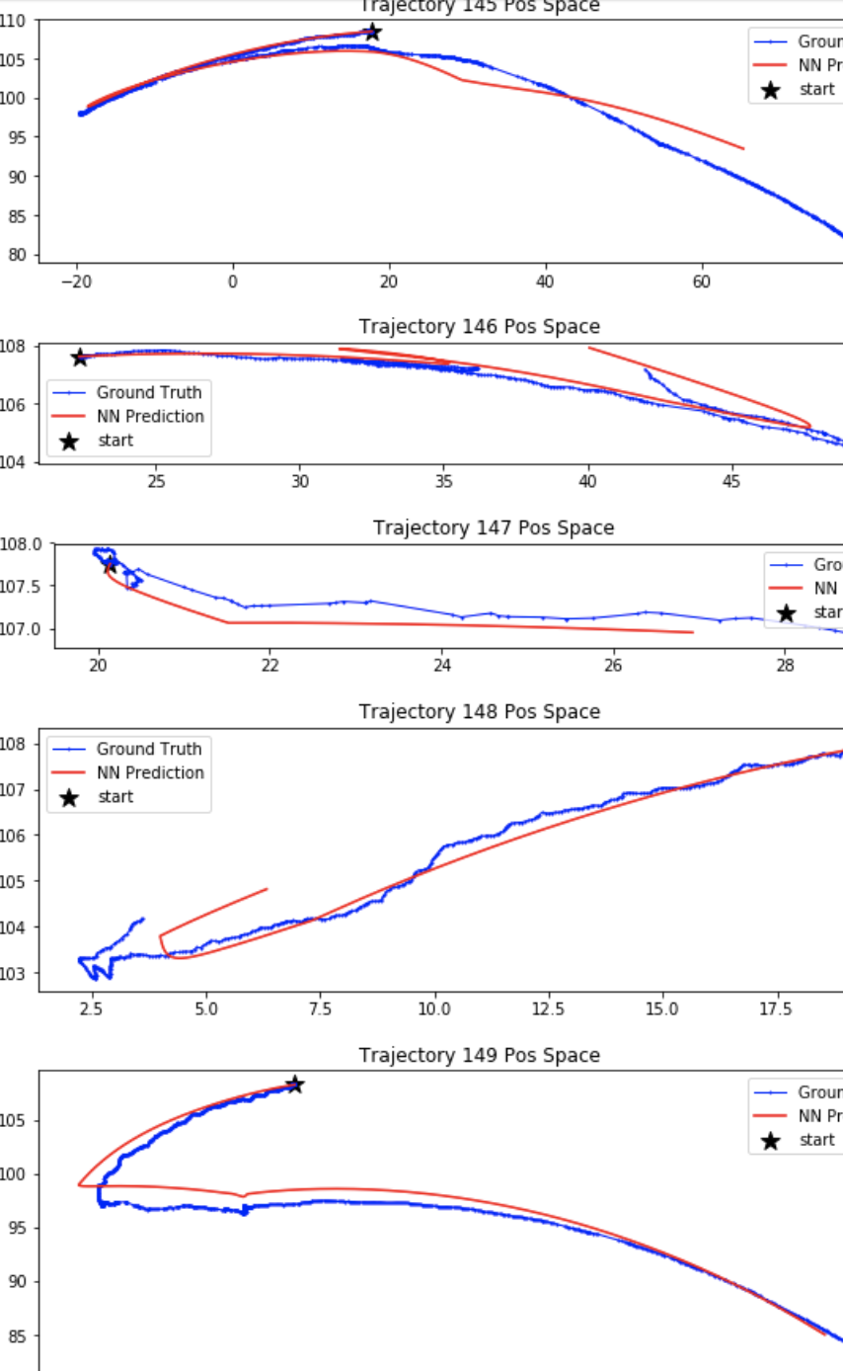
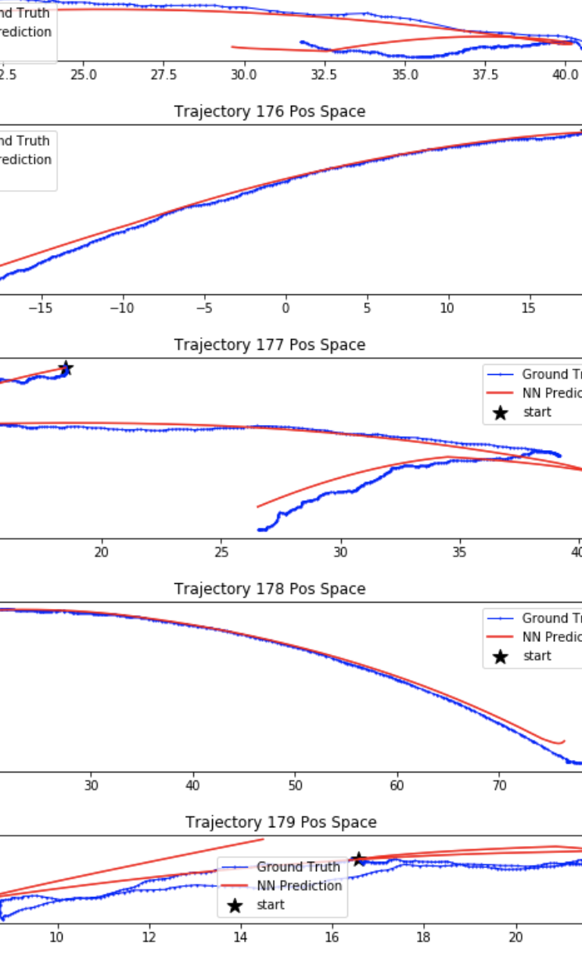

Slide 10
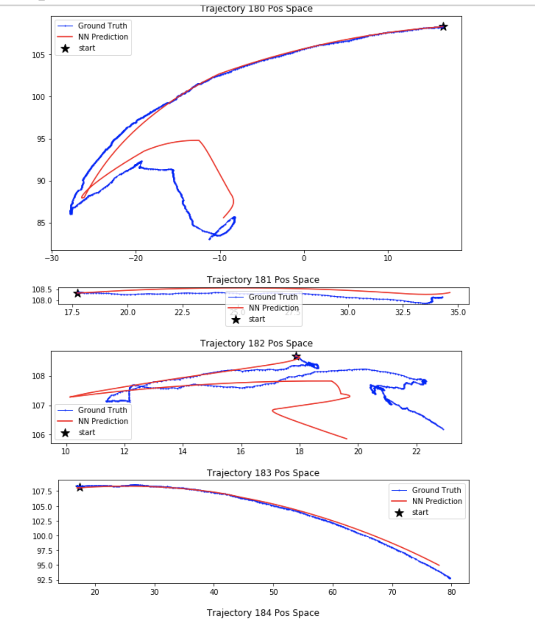
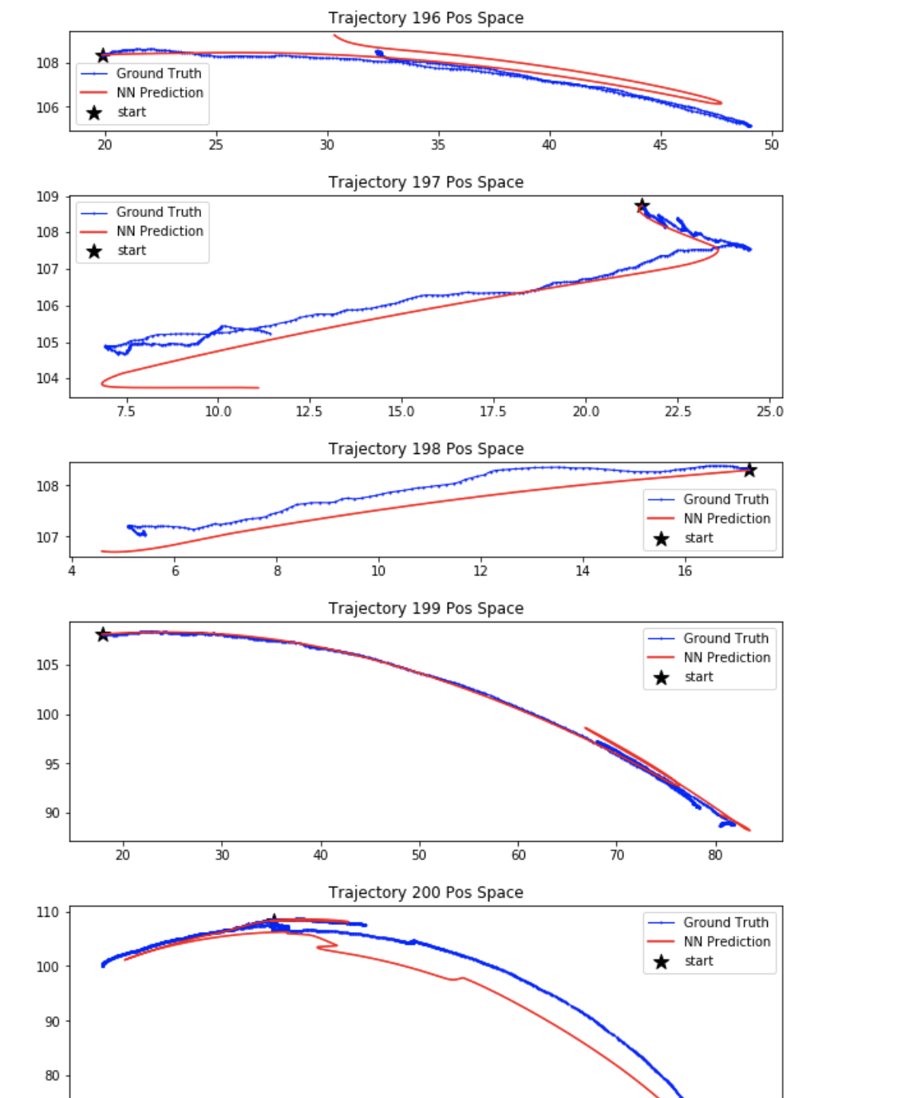
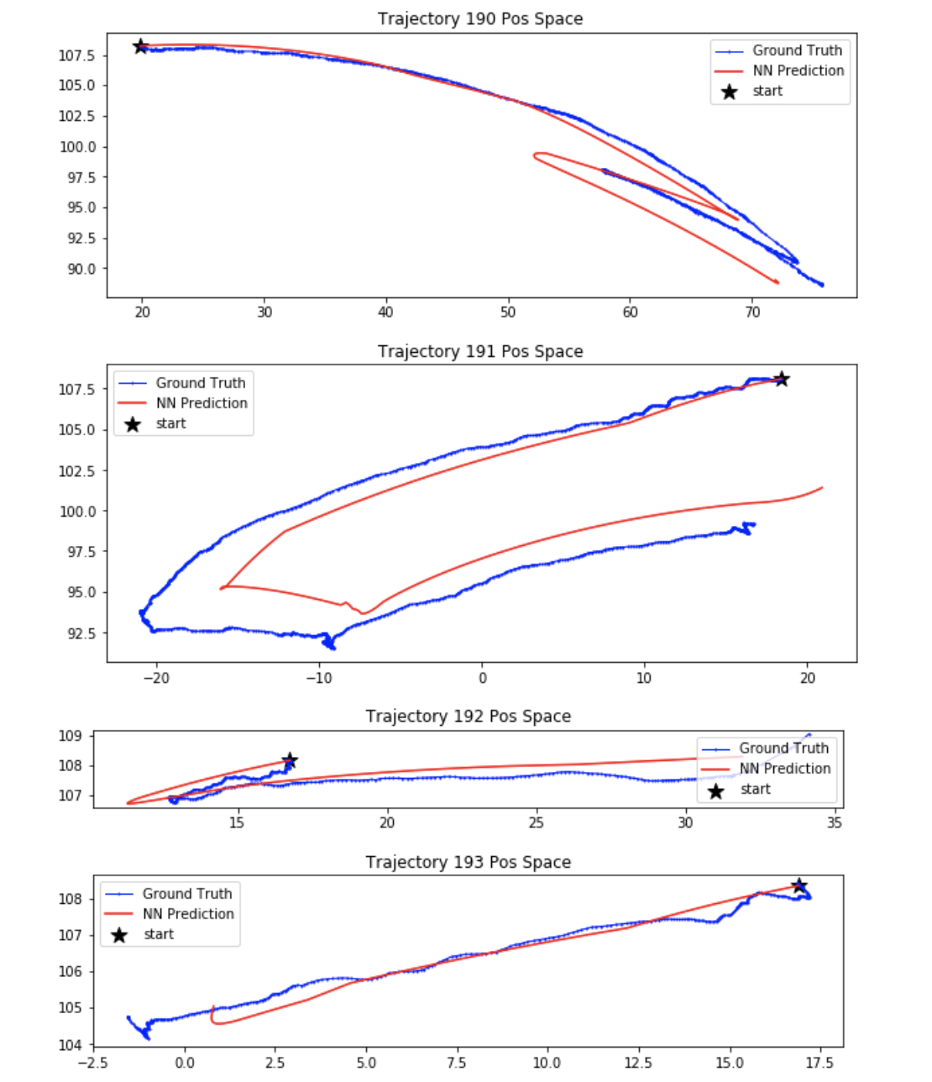

Slide 11
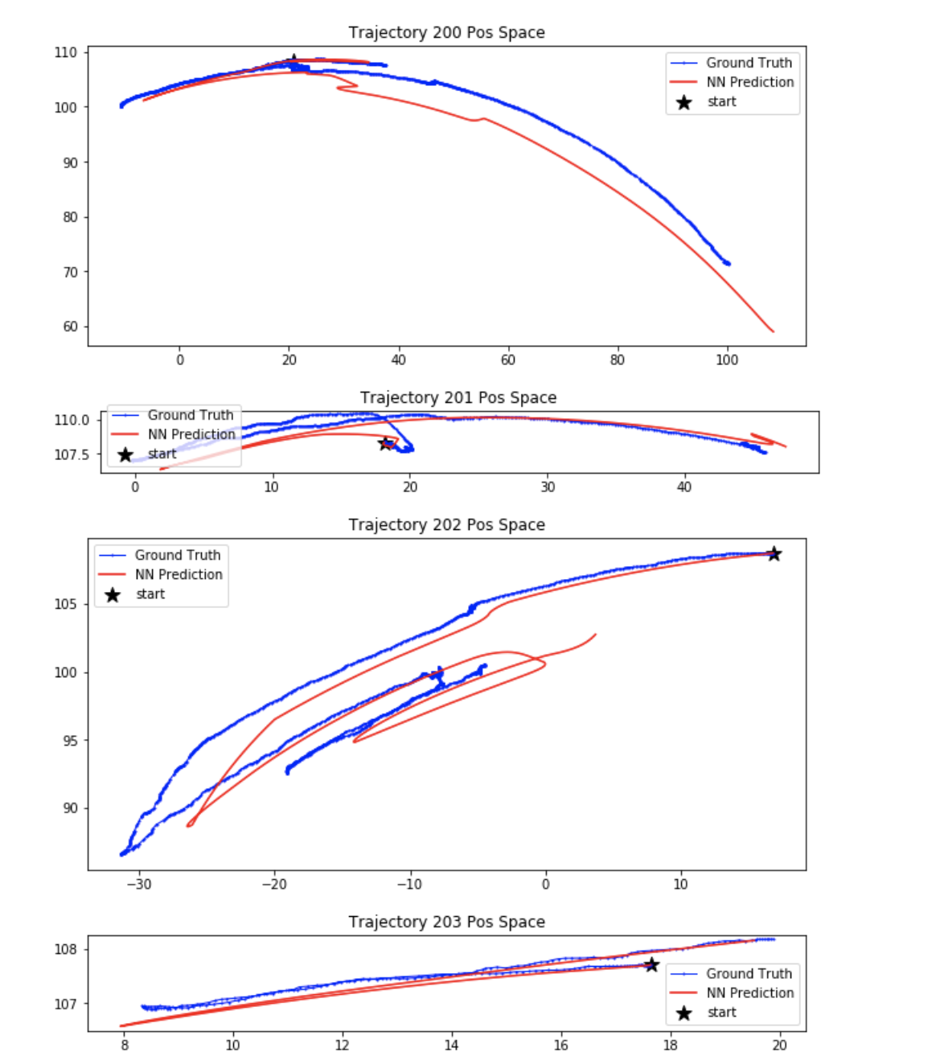
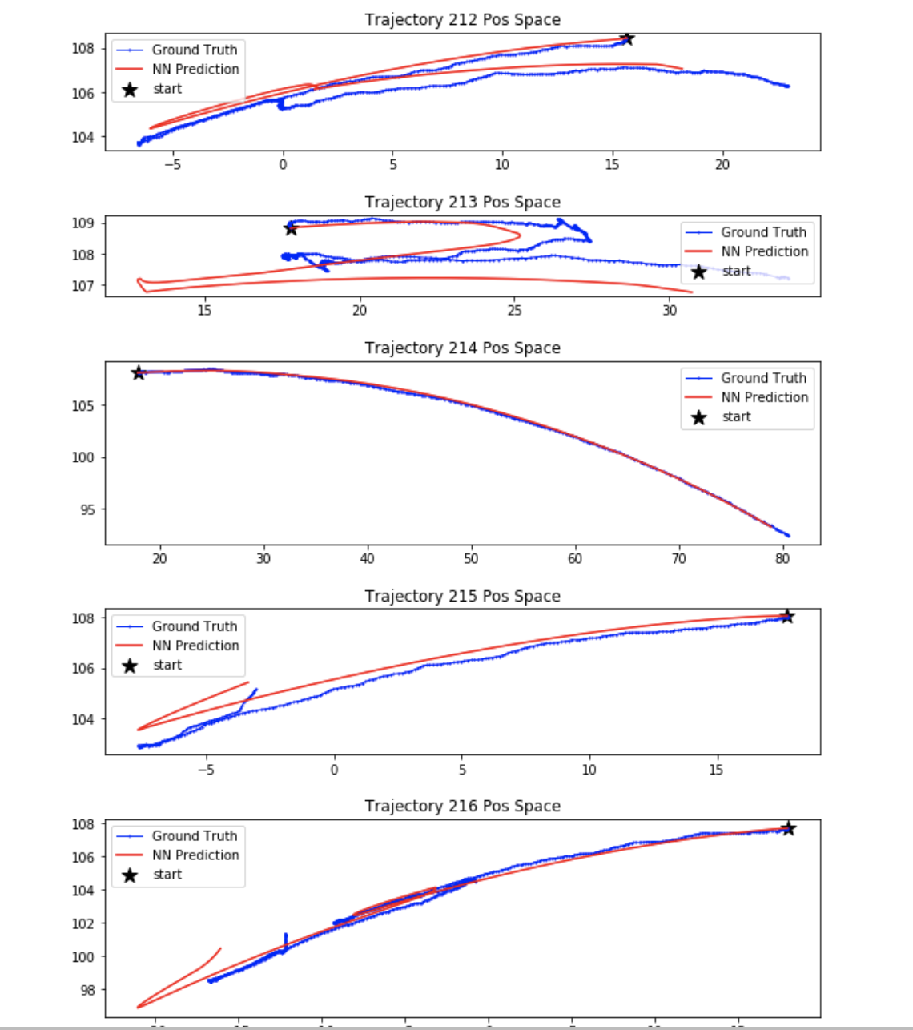
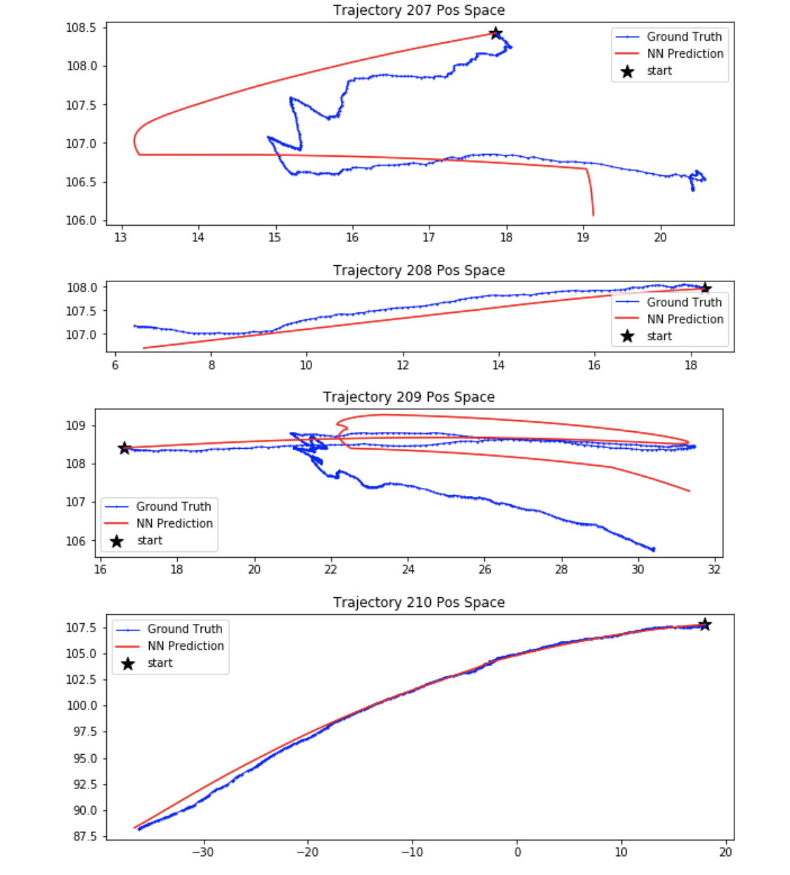

Slide 12
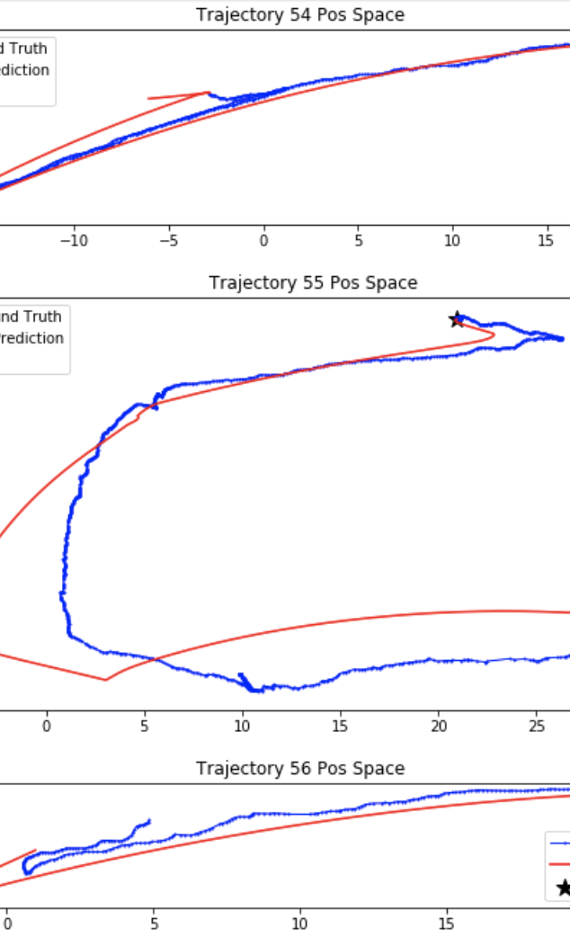
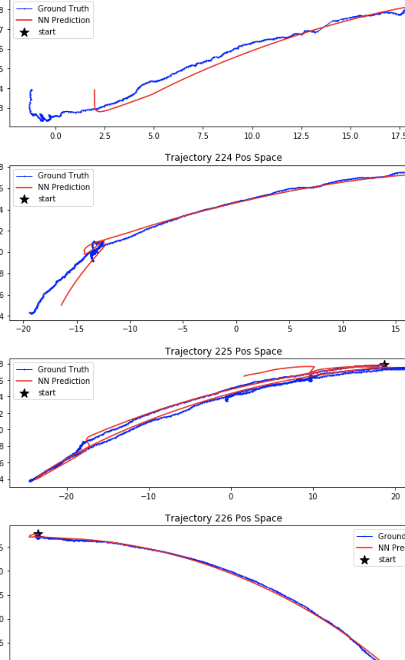
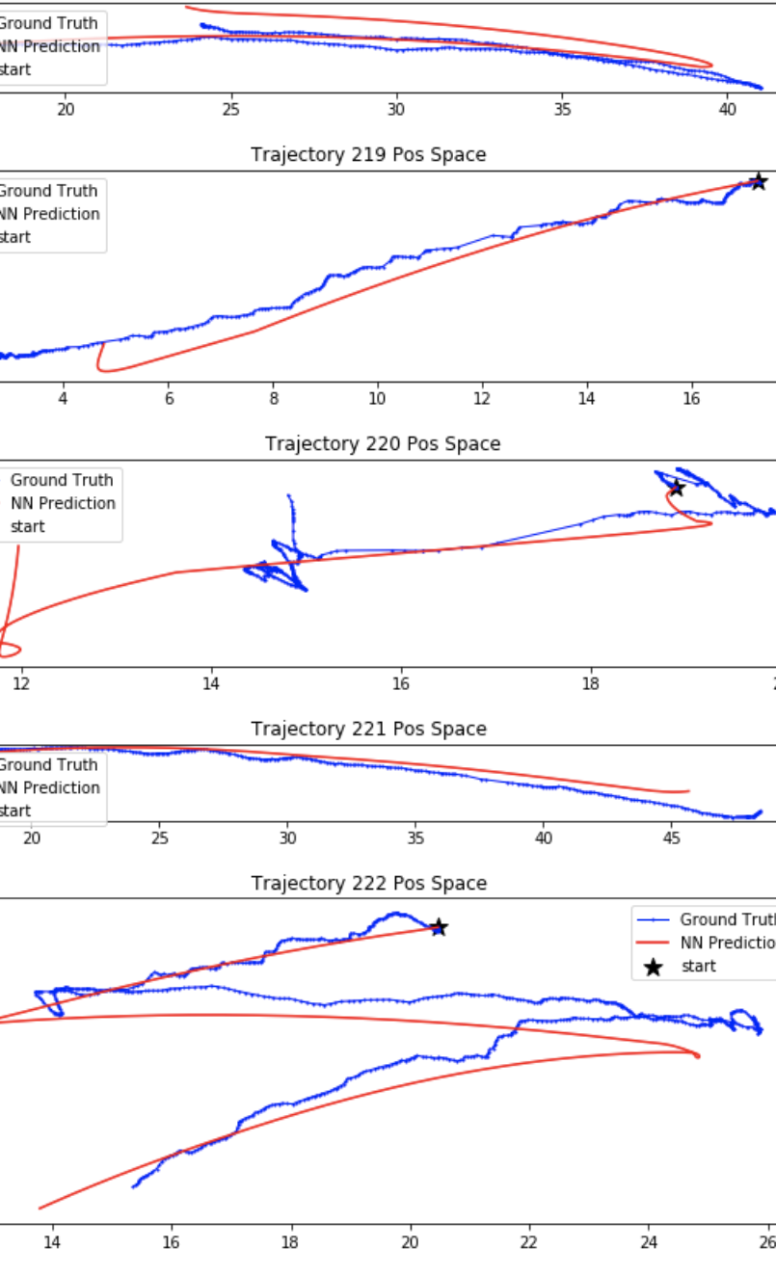

Slide 13
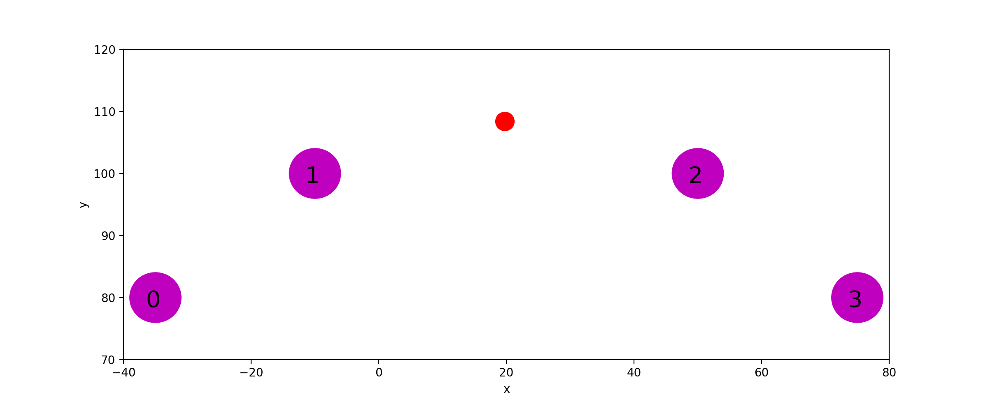
Real Hand PPO Training Issue
Returns are not stable.
Maybe I need to use a smaller learning rate and train more steps.

Slide 14
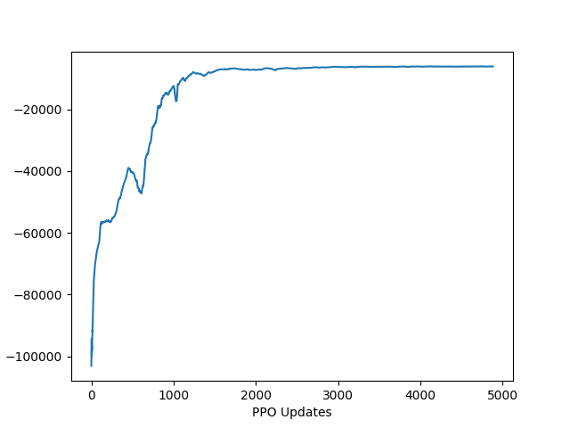
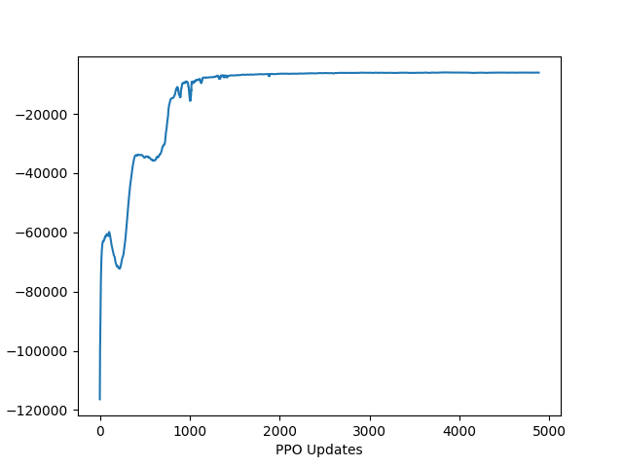
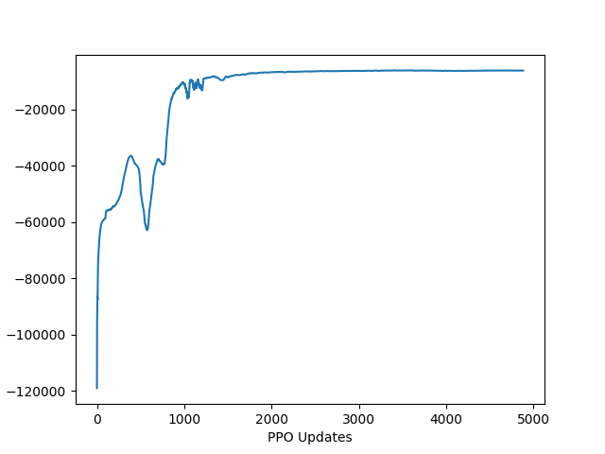
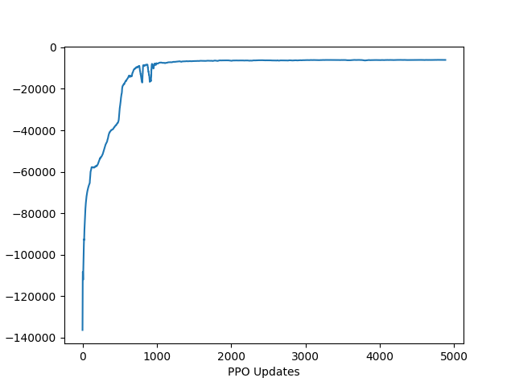
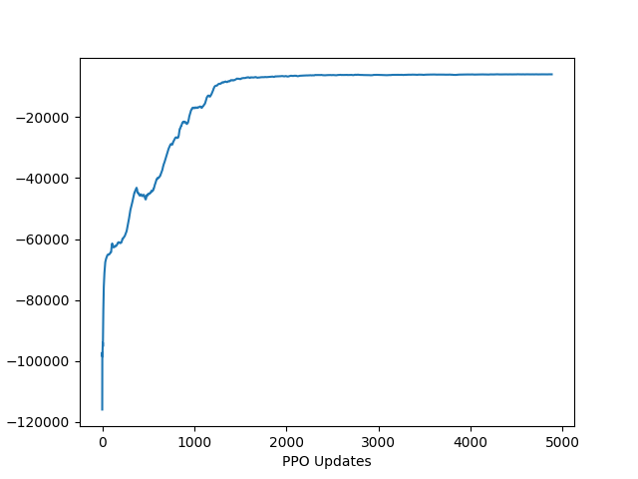
Adaptive Hand PPO: Goal Loc 8
learning rate: 1e-5; 10 million timesteps
With control reward (from seed 0 to seed 4)

Slide 15
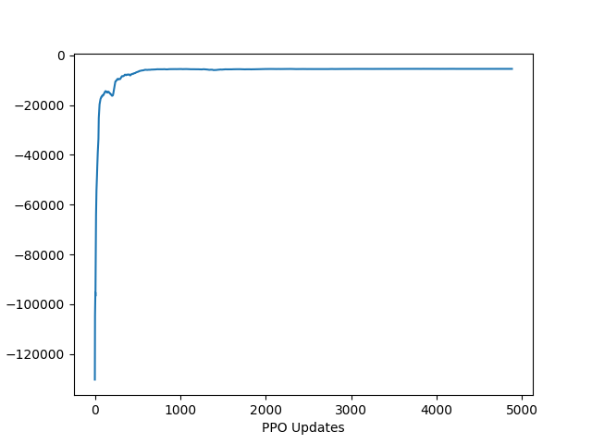
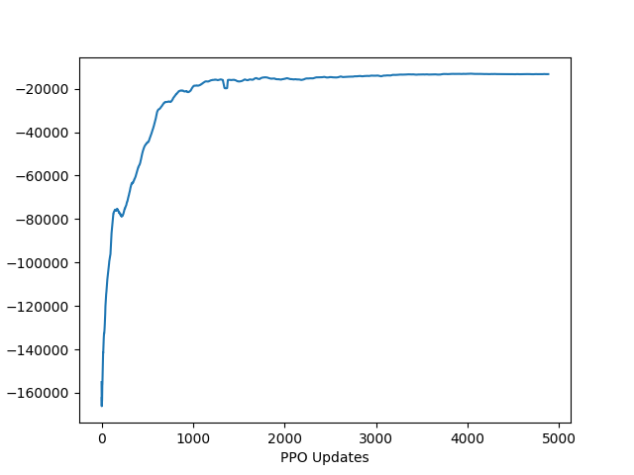
Adaptive Hand PPO: Different Goal Locations
learning rate: 1e-5; 10 million timesteps
With control reward: Goal Loc 7
With control reward: Goal Loc 0

Slide 16
To Do List
Mridul:
- Fix the issues of marker tracking
- Collect several episodes of data for testing my trained dynamics model
Fix the issues of PPO training on real hand model
(Hyperparameter search: Learning rate, Number of train steps, etc.)
Write a ros-package for rollouts of the real hand.
(Avishai’s previous rollout ros-package only works on the Motoman setup)
Test wether the trained real hand dynamics model also works with Mridul’s new data or not
Do rollouts for A* and PPO policy on real hand
Work on our new online method

